Slide 1
Class 8: Firm offers and formation under Article 2

Slide 2
Key questions
Is there an enforceable promise?
Has it been breached?
Has performance been excused?
How should it be enforced?

Slide 3
Topics
Firm offers
Battle of the forms

Slide 4
Firm offers

Slide 5
Limits on the power of revocation
A promise to hold an offer open is enforceable if:
  Supported by consideration
  Rendered enforceable by a statute such as UCC § 2-205 or NY Gen Oblig. L. § 5-1109.
  The offer is in writing and signed by the offeror, recites a purported consideration for the making of the offer, and proposes an exchange on fair terms within a reasonable time: Restatement § 87(1)
The Restatement calls an enforceable promise of this sort an “option contract” (Restatement § 25)
An offer may also become irrevocable when:
  It seeks acceptance by performance and the offeree tenders or begins performance: Restatement §§ 45 or 62.
  It has been relied upon: Restatement §87(2).

Slide 6
Problem: The Move to Maine (252)
“If you move to Maine and take care of me for the rest of my life you will have the place when I have passed away.”
“If you will agree to move to Lewiston and care for me for on the home place you will have the place when I have passed away.”
Is there a contract?
What if the offeror had died after the offerees sold their home and business but before they moved to Maine?

Slide 7
Notification of acceptance by performance
§ 54 Acceptance by Performance; Necessity of Notification to Offeror
(1) Where an offer invites an offeree to accept by rendering a performance, no notification is necessary to make such an acceptance effective unless the offer requests such a notification.
(2) If an offeree who accepts by rendering a performance has reason to know that the offeror has no adequate means of learning of the performance with reasonable promptness and certainty, the contractual duty of the offeror is discharged unless
(a) the offeree exercises reasonable diligence to notify the offeror of acceptance, or
(b) the offeror learns of the performance within a reasonable time, or
(c) the offer indicates that notification of acceptance is not required.

Slide 8
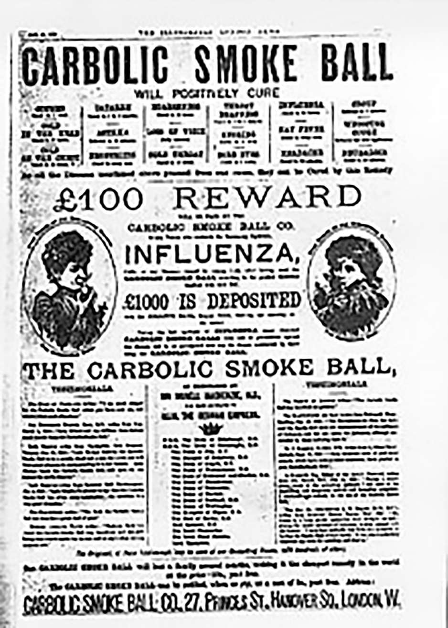

Slide 9
Carlill v. Carbolic Smoke Ball (228)
“£100 reward will be paid by the Carbolic Smoke Ball Company to any person who contracts the influenza after having used the ball three times daily for two weeks according to the printed directions supplied with each ball...£1000 is deposited with the Alliance Bank, shewing our sincerity in the matter.”
Was the advertisement an offer?
Could it be revoked before Mrs. Carlill notified them of her claim?
Could it be revoked after she bought the smoke ball but before she had used it as directed? Before she contracted influenza?
What was the consideration?

Slide 10
Drennan v. Star Paving (253)
What was the offer?
Was there any indication that it was irrevocable?
What form of acceptance was sought?
Did Drennan do anything that could be construed as acceptance prior to revocation?
Did Drennan rely on the offer?
How would this case be resolved in New York?
How did the court justify making the offer irrevocable?
Why might a bidder be reluctant to make an irrevocable offer? What did the court do to alleviate those concerns?

Slide 11
Battle of the forms

Slide 12
Battle of the forms at common law
Form 1 | Form 2 | Conduct/Performance
Invitation to treat | Offer | Acceptance of offer.
Offer | Rejection and counter-offer if it does not exactly mirror the terms of the original offer. | Acceptance of counter-offer.

Slide 13
UCC § 2-204 – Formation in general
(1) A contract for sale of goods may be made in any manner sufficient to show agreement, including conduct by both parties which recognizes the existence of such a contract.
(2) An agreement sufficient to constitute a contract for sale may be found even though the moment of its making is undetermined.

Slide 14
UCC § 2-207 – Formation rules
(1) A definite and seasonable expression of acceptance or a written confirmation which is sent within a reasonable time operates as an acceptance even though it states terms additional to or different from those offered or agreed upon, unless acceptance is expressly made conditional on assent to the additional or different terms.
…
(3) Conduct by both parties which recognizes the existence of a contract is sufficient to establish a contract for sale although the writings of the parties do not otherwise establish a contract….

Slide 15
UCC § 2-207 – Interpretation rules
(2) The additional terms are to be construed as proposals for addition to the contract. Between merchants such terms become part of the contract unless:
(a) the offer expressly limits acceptance to the terms of the offer;
(b) they materially alter it; or
(c) notification of objection to them has already been given or is given within a reasonable time after notice of them is received.
…
(3) [If the writings of the parties do not otherwise establish a contract] the terms of the particular contract consist of those terms on which the writings of the parties agree, together with any supplementary terms incorporated under any other provisions of this Act.

Slide 16
Battle of the forms under UCC § 2-207
Form 1 | Form 2 | Conduct/Performance
Invitation to treat | Offer | Acceptance?
Offer | Rejection or counter-offer if (2-207(1)): Not a definite expression of acceptance Not seasonable; or Expressly conditional on assent to additional or different terms | Trigger for 2-207(3) Acceptance?
Offer | Acceptance (2-207(1)) and proposal whose terms are not incorporated (2-207(2)) if: Contract is not between merchants Offer expressly limits acceptance They materially alter contract Notification of objection is given; or Terms are different (leading minority rule, consistent with statutory text)
Offer | Acceptance that knocks out different terms (majority “knockout” rule).
Offer | Acceptance (2-207(1)) and proposal whose terms are incorporated into contract (2-207(2) (“California” rule, implied by Cmt 3)).

Slide 17
Confirmations under UCC § 2-207
Agreement | Form | Conduct/Performance
Contract* | Document other than a confirmation whose terms are not incorporated.
Contract* | Proposal whose terms are not incorporated (2-207(2)) if: Contract is not between merchants Offer expressly limits acceptance They materially alter contract Notification of objection is given (including in a conflicting confirmation, as per Cmt 6); or Terms are different (minority rule, consistent with statutory text)
Contract* | Proposal whose terms are incorporated into contract (2-207(2) (“California” rule, implied by Cmt 3)).
* Subject to writing requirement, which might be satisfied by the confirmation, and interpreted in light of commercial context.

Slide 18
Dorton v. Collins & Aikman Corp. (276)
“This order is given subject to all of the terms and conditions on the face and reverse side hereof, including the provisions for arbitration and the exclusion of warranties, all of which are accepted by Buyer, supersede Buyer's order form, if any, and constitute the entire contract between Buyer and Seller. This order shall become a contract as to the entire quantity specified either (a) when signed and delivered by Buyer to Seller and accepted in writing by Seller or (b) when Buyer has received and retained this order for ten days without objection, or (c) when Buyer has accepted delivery of any part of the merchandise specified herein or has furnished to Seller specifications or assortments, delivery dates, shipping instructions, or instructions to bill and hold, or when Buyer has otherwise indicated acceptance of the terms hereof.”

Slide 19
Dorton v. Collins & Aikman Corp.
Order | Acknowledgement “subject to” arbitration clause | Delivery
Invitation to treat | Offer | Acceptance?
Offer | Rejection or counter-offer if (2-207(1)): Not a definite expression of acceptance Not seasonable; or Expressly conditional on assent to additional or different terms | Trigger for 2-207(3) Acceptance?
Offer | Acceptance (2-207(1)) and proposal whose terms are not incorporated (2-207(2)) if: Contract is not between merchants Offer expressly limits acceptance They materially alter contract Notification of objection is given; or Terms are different (minority rule, consistent with statutory text)
Offer | Acceptance that knocks out different terms (majority “knockout” rule).
Offer | Acceptance (2-207(1)) and proposal whose terms are incorporated into contract (2-207(2) (“California” rule, implied by Cmt. 3)).

Slide 20
Dorton v. Collins & Aikman Corp. – District Ct.
Order | Acknowledgement “subject to” arbitration clause | Delivery
Invitation to treat | Offer | Acceptance?
Offer | Rejection or counter-offer if (2-207(1)): Not a definite expression of acceptance Not seasonable; or Expressly conditional on assent to additional or different terms | Trigger for 2-207(3) Acceptance?
Offer | Acceptance (2-207(1)) and proposal whose terms are not incorporated (2-207(2)) if: Contract is not between merchants Offer expressly limits acceptance They materially alter contract Notification of objection is given; or Terms are different (minority rule, consistent with statutory text)
Offer | Acceptance that knocks out different terms (majority “knockout” rule).
Offer | Acceptance (2-207(1)) and proposal whose terms are incorporated into contract (2-207(2) (“California” rule, implied by Cmt. 3)).

Slide 21
Dorton v. Collins & Aikman Corp. – 6th Cir.
Order | Acknowledgement “subject to” arbitration clause | Delivery
Invitation to treat | Offer | Acceptance?
Offer | Rejection and counter-offer if (2-207(1)): Not a definite expression of acceptance Not seasonable; or Expressly conditional on assent to additional or different terms | Trigger for 2-207(3) Acceptance?
Offer | Acceptance (2-207(1)) and proposal whose terms are not incorporated (2-207(2)) if: Contract is not between merchants Offer expressly limits acceptance They materially alter contract Notification of objection is given; or Terms are different (minority rule, consistent with statutory text)
Offer | Acceptance that knocks out different terms (majority “knockout” rule).
Offer | Acceptance (2-207(1)) and proposal whose terms are incorporated into contract (2-207(2) (“California” rule, implied in Cmt. 3)).

Slide 22
Dorton v. Collins & Aikman Corp. – 6th Cir. (cont.)
Order | Acknowledgement “subject to” arbitration clause | Delivery
Oral agreement* | Document other than a confirmation whose terms are not incorporated.
Oral agreement* | Proposal whose terms are not incorporated (2-207(2)) if: Contract is not between merchants Offer expressly limits acceptance They materially alter contract Notification of objection is given (including in a conflicting confirmation, as per Cmt 6); or Terms are different (minority rule, consistent with statutory text)
Oral agreement* | Proposal whose terms are incorporated into contract (2-207(2) (“California” rule, implied in Cmt 3)).
* Subject to writing requirement, which might be satisfied by the confirmation, and interpreted in light of commercial context.

Slide 23
C. Itoh & Co. (America) Inc. v. Jordan Int’l Co. (281)
Purchase Order | Acceptance “expressly conditional on Buyer’s assent to” arbitration clause | Delivery and payment
Invitation to treat | Offer | Acceptance?
Offer | Rejection and counter-offer if (2-207(1)): Not a definite expression of acceptance Not seasonable; or Expressly conditional on assent to additional or different terms | Trigger for 2-207(3) Acceptance?
Offer | Acceptance (2-207(1)) and proposal whose terms are not incorporated (2-207(2)) if: Contract is not between merchants Offer expressly limits acceptance They materially alter contract Notification of objection is given; or Terms are different (minority rule, consistent with statutory text)
Offer | Acceptance that knocks out different terms (majority “knockout” rule).
Offer | Acceptance (2-207(1)) and proposal whose terms are incorporated into contract (2-207(2) (“California” rule, implied in Cmt. 3)).

Slide 24
Bayway Refining v. Oxygenated Marketing & Trading (285)
“A material alteration is one which would result in surprise or hardship if incorporated without express awareness by the other party” (2-207 Cmt 4).
  See examples in Comments 4 and 5. Note relevance of usage of trade, custom, trade practice.
Who bears the burden of establishing that a term would be a material alteration?
Why was the Tax Clause not a material alteration?
Is an arbitration clause necessarily a material alteration?

Slide 25
Northrop Corp. v. Litronic Industries (290)
Offer with 90 day warranty | Invoice with unlimited warranty | Delivery
Invitation to treat | Offer | Acceptance?
Offer | Rejection or counter-offer if (2-207(1)): Not a definite expression of acceptance Not seasonable; or Expressly conditional on assent to additional or different terms | Trigger for 2-207(3) Acceptance?
Offer | Acceptance (2-207(1)) and proposal whose terms are not incorporated (2-207(2)) if: Contract is not between merchants Offer expressly limits acceptance They materially alter contract Notification of objection is given; or Terms are different (minority rule, consistent with statutory text)
Offer | Acceptance that knocks out different terms (majority “knockout” rule).
Offer | Acceptance (2-207(1)) and proposal whose terms are incorporated into contract (2-207(2) (“California” rule, implied in Cmt. 3)).

Slide 26
Northrop Corp. v. Litronic Industries – 7th Cir.
Offer with 90 day warranty | Invoice with unlimited warranty | Delivery
Invitation to treat | Offer | Acceptance?
Offer | Rejection or counter-offer if (2-207(1)): Not a definite expression of acceptance Not seasonable; or Expressly conditional on assent to additional or different terms | Trigger for 2-207(3) Acceptance?
Offer | Acceptance (2-207(1)) and proposal whose terms are not incorporated (2-207(2)) if: Contract is not between merchants Offer expressly limits acceptance They materially alter contract Notification of objection is given; or Terms are different (minority rule, consistent with statutory text)
Offer | Acceptance that knocks out different terms (majority “knockout” rule).
Offer | Acceptance (2-207(1)) and proposal whose terms are incorporated into contract (2-207(2) (“California” rule, implied in Cmt. 3)).

Slide 27
Problem: Misplaced Strategies (293)
Buyer’s [plaintiff] purchase order (with arbitration clause):
“This purchase order represents the entire agreement between both parties, not withstanding any Seller's order form, whether sent before or after the sending of this purchase order, and this document cannot be modified except in writing and signed by an authorized representative of the buyer.”
Seller’s invoice (silent on arbitration):
“This document is not an Expression of Acceptance or a Confirmation document as contemplated in Section 2–207 of the Uniform Commercial Code. The acceptance of any order entered by [Buyer] is expressly conditioned on [Buyer’s] assent to any additional or conflicting terms contained herein.”

Slide 28
Offeror’s strategies
Form 1 | Form 2 | Conduct/Performance
Invitation to treat | Offer | Acceptance?
Offer* | Rejection and counter-offer if (2-207(1)): Not a definite expression of acceptance Not seasonable; or Expressly conditional on assent to additional or different terms | Acceptance? Trigger for 2-207(3)?
Offer* | Acceptance (2-207(1)) and proposal whose terms are not incorporated (2-207(2)) if: Contract is not between merchants Offer expressly limits acceptance They materially alter contract Notification of objection is given; or Terms are different (minority rule, consistent with statutory text)
Offer* | Acceptance that knocks out different terms (majority “knockout” rule).
Offer* | Acceptance (2-207(1)) and proposal whose terms are incorporated into contract (2-207(2) (“California” rule, implied in Cmt. 3)).

Slide 29
Offeree’s strategies
Form 1 | Form 2 | Conduct/Performance
Invitation to treat | Offer | Acceptance?
Offer | Rejection and counter-offer if (2-207(1)): Not a definite expression of acceptance Not seasonable; or Expressly conditional on assent to additional or different terms | Acceptance? Trigger for 2-207(3)?
Offer | Acceptance (2-207(1)) and proposal whose terms are not incorporated (2-207(2)) if: Contract is not between merchants Offer expressly limits acceptance They materially alter contract Notification of objection is given; or Terms are different (minority rule, consistent with statutory text)
Offer | Acceptance that knocks out different terms (majority “knockout” rule).
Offer | Acceptance (2-207(1)) and proposal whose terms are incorporated into contract (2-207(2) (“California” rule, implied in Cmt. 3)).

Slide 30
Policy considerations
Rules can be evaluated in terms of:
Respect for intention of parties
Fairness
Certainty
Litigation costs
Drafting costs
Have to consider how rules affect incentives to:
negotiate master agreements
draft clear, reasonable forms
litigate

